Slide 1
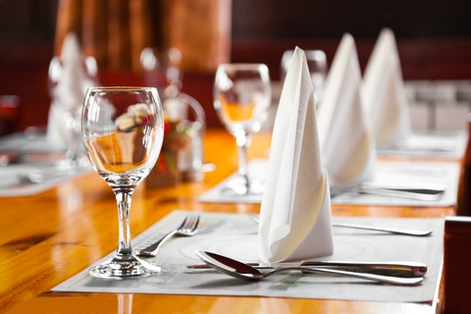

Slide 2
Basic Dinning Etiquette
Ms.Manisha Gunasekera
BA (English) University of Peradeniya, Diploma in HRM & OB, Reading for the PG Dip. in International Relations

Slide 3
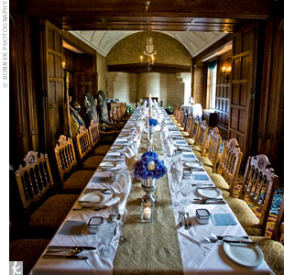

Slide 4
Sit Down and Claim Your Property
Be polite
Usually the man pulls the chair for the woman – no need to do it ALWAYS…
If you’re a guest at someone’s house, don’t sit until the host sits first
Never do anything until the host does it first

Slide 5
Your drink is always on the right
If you’re the host – salad, meal, wine and water should be brought to each diner’s right and cleared from left

Slide 6
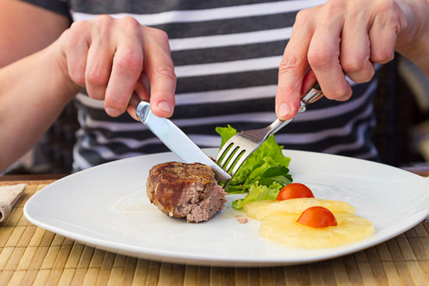

Slide 7
Use Your Utensils Correctly
Place your napkin in your lap right away when you sit down
Don’t try to snap it open

Slide 9
Use your utensils from the outside in
If you’re not sure what to do, wait and see what your neighbor does. If that offers no clue, just fake it
Never let any utensils, once used, ever touch the table again
Do not put the entire soup spoon in your mouth

Slide 10
If you spill something, don’t make a big deal of it
If you’re not sure whether or not you can eat something with your fingers, just use a utensil

Slide 11
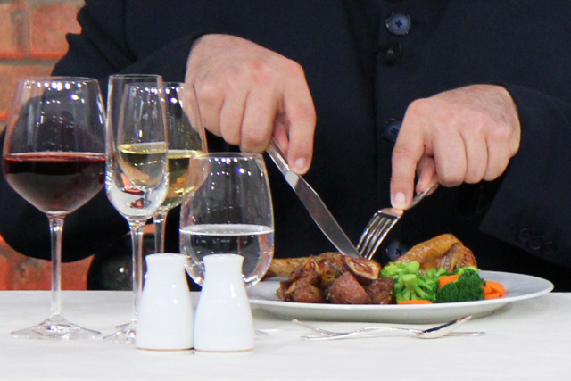
Eat Properly

Slide 12
Posture
Passing
Salt and pepper
Embarrassing moments

Slide 13
Don’ts
Don’t grab food
Don’t talk with your mouth full
Chew with your mouth closed and no noise
Excuse yourself if you get up to go somewhere
Don’t pick something out of your teeth
Don’t leave lipstick smears on anything

Slide 14
Don’t put items on the table
Don’t smoke
Don’t tilt or squirm in your chair
Don’t keep your elbows on the table while eating
Never talk with food in your mouth
Don’t use your fingers to push food in to your mouth or spoon

